Slide 1
Best practices for Magento debugging
Erik Hansen | CO-Founder and Director of Technology At Classy Llama Studios
Notes:
• Been doing Magento development for three years. Have come up with ways to more efficiently solve problems and solve bugs. Want to share them with you all.

Slide 2
Overview
Environment configuration
PHP debugging with Magento/Eclipse
Common Magento development problems
Mage::log()
Quick tips
Notes:
I won’t be covering everything in minute detail. At the end of the presentation, I’ll provide a link to slideshow and link to blog posts explaining different sections in more detail.
It will be a bit random
Some of you will know this stuff

Slide 3
The Imagine Conference has been excellently planned, but… they made one fatal mistake…
One important detail: My name is Erik Hansen
Notes:
They even used my slideshow colors

Slide 4

Erik != Eric

Slide 5
Environment configuration

Slide 6

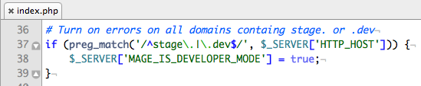
Enable Developer Mode
Enable Mage::isDeveloperMode() on development and staging environments
      Preferably, set the MAGE_IS_DEVELOPER_MODE via .htaccess file or server configuration. Example:
      Alternatively, set the developer mode using conditional code in index.php:
Notes:
• If you have a dedicated stage/dev server, you should setup a global environment variable in your server’s config
• Benefit of second method is that you can deploy one codebase without having to change .htaccess file on independent servers.

Slide 7
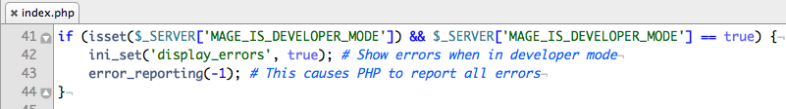
Show all errors in developer mode
Modify index.php with this conditional code to ensure that all errors are displayed when in developer mode:
Notes:
• This is elementary, but you want to display errors only on dev/stage environments
• Sometimes you have issues with E_NOTICE being turned on, during the checkout and possibly some places in the admin

Slide 8
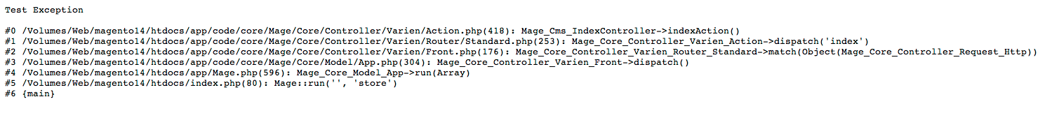
NATIVE MAGENTO EXCEPTIONS

Slide 9
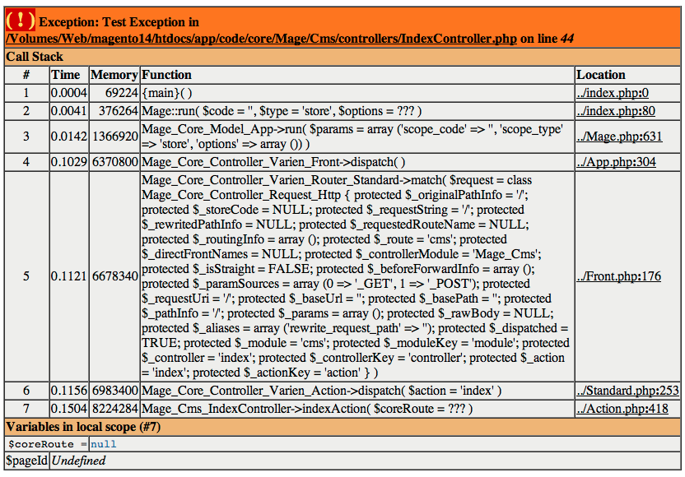
vs. XDEBUG EXCEPTIONS
Links to the location the file
Fully expanded argument variables
Local variables
Notes:
You can see all arguments passed to functions in the call stack
You can see all local variables at the location of the error/exception
You can customize xdebug to create links that allow you to jump to a specific line/file in your favorite editor

Slide 10
INSTALL xdebug
Install Xdebug (an Apache module) on your development/staging servers
My recommended xdebug configuration values: http://bit.ly/gspkIK

Slide 11
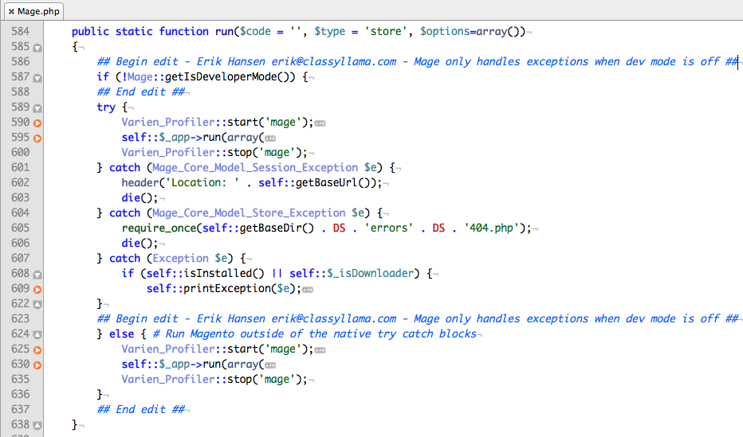
MODIFY THE Mage CLASS
Modify the Mage::run() method to not catch exceptions if developer mode is on (blog post explaining how to make this modification: http://bit.ly/feJE2y)
Notes:
• Any time you modify core files, have a standard comment notation so you can search codebase for all edits
• Make joke about hacking the core

Slide 12
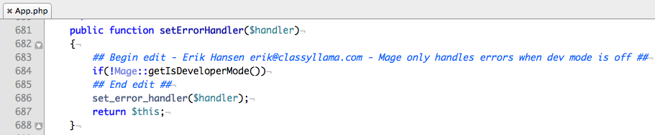
MODIFY THE Mage_Core_Model_App CLASS
Modify the Mage_Core_Model_App::setErrorHandler() method to not set an error handler if developer mode is on (blog post explaining how to make this modification: http://bit.ly/co1qc4 )

Slide 13
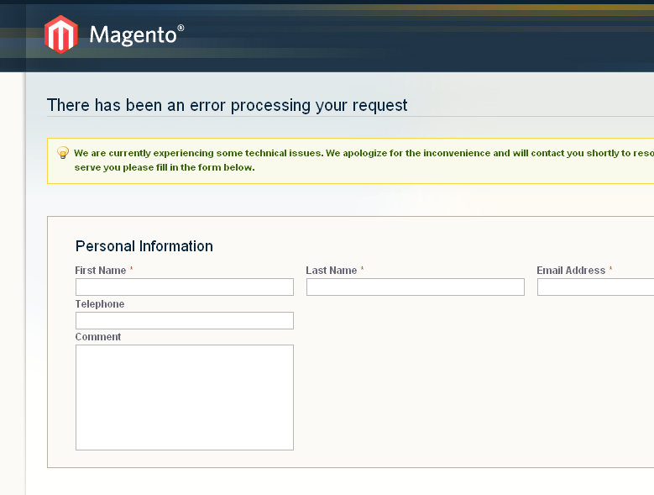
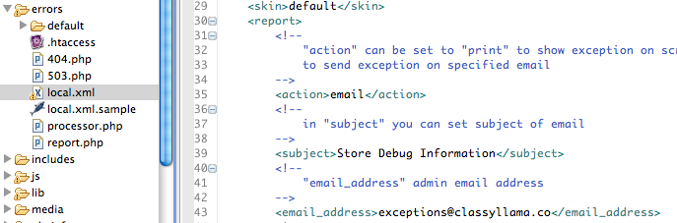
Configure Exception Handler To Email Reports ON a PRODUCTION Site
Optimize the way that exceptions are handled on a production site
Configure Magento to send email upon every exception
Notes:
Use case: You’ve launched a site in production or staging. Users get errors. You either have to check var/logs/exceptions.log on a regular basis, or you can setup to get emailed with these notifications so that you can preempt a store owner contacting you about an issue.
This should only be setup this way on a production site. On a development site, you should use xdebug’s exception handling.
• Copy errors/local.xml.template to errors/local.xml
• The generated exception will be logged to var/log/exceptions.log

Slide 14
PHP debugging with Magento/Eclipse
Notes:
Use cases for debugging:
• Understanding how the core system works
• Determining non-obvious bugs in your code – ie, bugs that don’t throw errors/exceptions

Slide 15
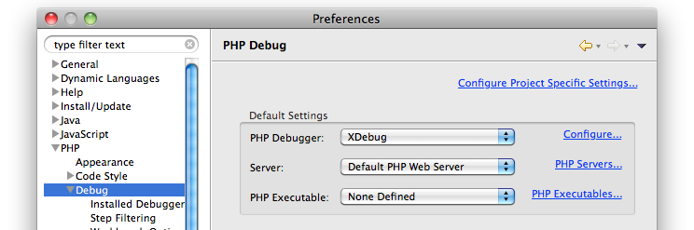
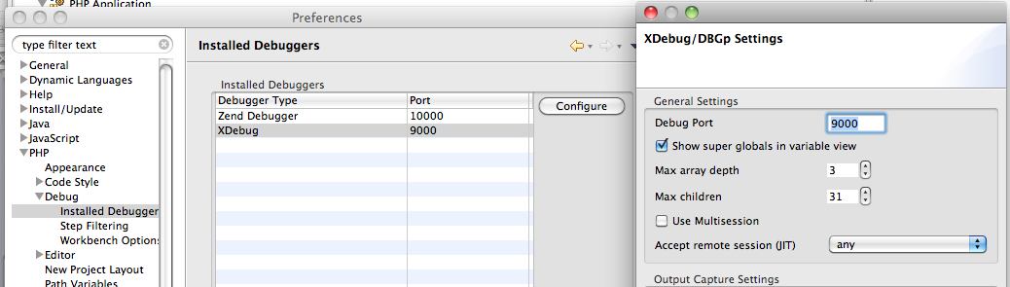
Basic Xdebug/Eclipse Setup
Xdebug – Use config setting from previous slide
Eclipse – Follow configuration instructions below:
1
2
Notes:
Eclipse = PDT or Zend Studio

Slide 16
Link to video: http://www.youtube.com/watch?v=6AynpmjW5us

Slide 17
Common Magento development problems

Slide 18
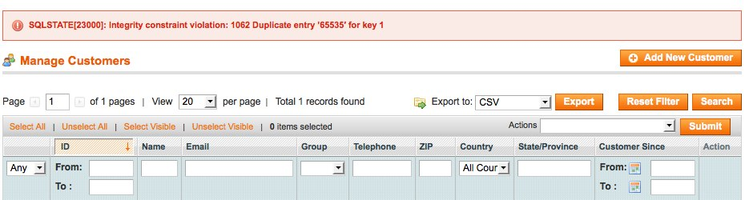
Uncover the source of SQLSTATE errors
What do you do when Magento throws a generic SQLSTATE database error?
Notes:
• Example errors: Lock wait timeout, integrity constraint errors, out of memory, etc...
Especially relevant for errors encountered in the admin panel
Modify (harmlessly) two files

Slide 19
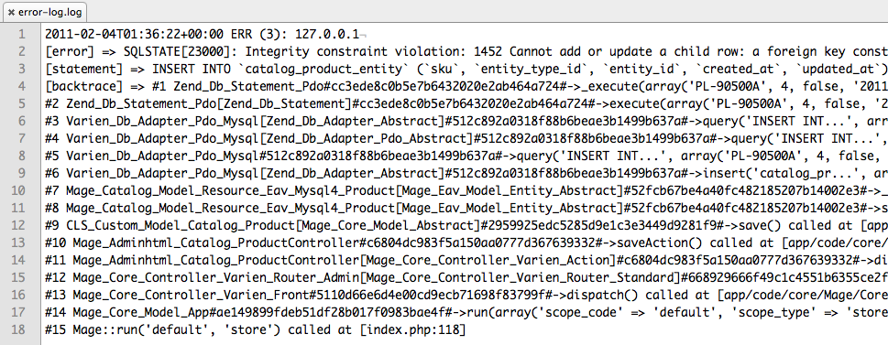
Uncover the source of SQLSTATE errors
Example log file from SQLSTATE error
SQL error message
Faulty SQL query
Backtrace up to point of exception

Slide 20
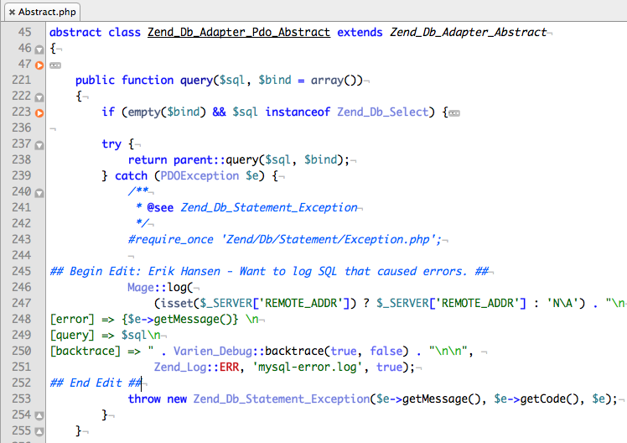
Uncover the source of SQLSTATE errors
Modify Zend_Db_Adapter_Pdo_Abstract to get backtraces for single queries.
Copy to app/code/local/Zend/Db/Adapter/Pdo/Abstract.php

Slide 21
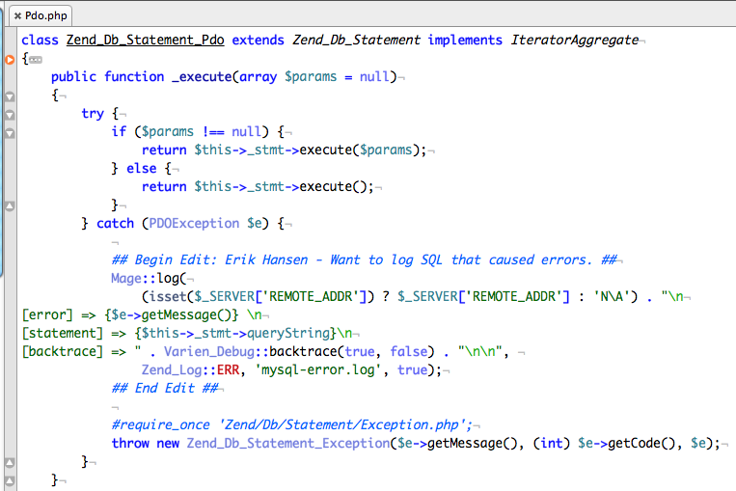
Uncover the source of SQLSTATE errors
Modify Zend_Db_Statement_Pdo to get backtraces for transactional query errors
Copy to app/code/local/Zend/Db/Adapter/Pdo/Abstract.php

Slide 22
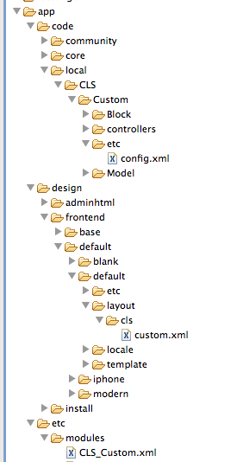

things to check when a CUSTOM MODULE DOESN’T LOAD
Problem: You’ve created a basic skeleton of a module with a module xml file, config.xml file, layout file, and block, but the module isn’t showing. Here are some quick steps you can take to debug the issue:
2
3
1
Notes:
Check if the module’s xml file is loading
Create a syntax error
Check if the module’s config.xml file is loading
Check if the layout file is loading
Make sure caching is disabled
remove the cache directory if it exists (var/cache)

Slide 23
Debugging by Process of Elimination
Problem: You are working on a site with 5 third-party modules and 9 custom modules. You’ve heavily modified the way that products work in the system. You run into an error where products aren’t saving from the admin.
You can either:
      Work backward by reading code OR:
      Isolate the issue by disabling modules
Notes:
A completely different approach than jumping directly into the code. Helps isolate the problem

Slide 24
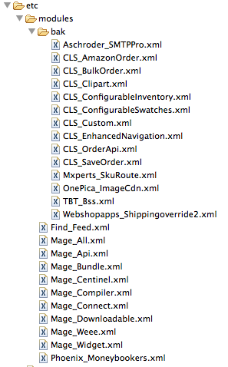
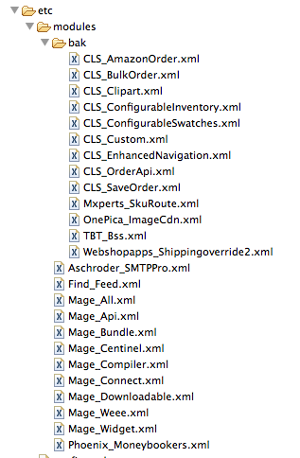
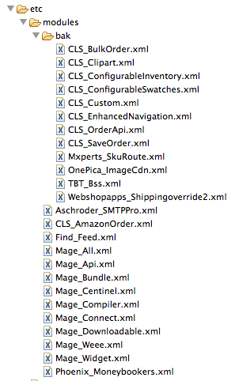
Debugging by Process of Elimination
Disable all custom modules, then selectively re-enable modules until you’ve
found the problematic module
1
2
3

Slide 25
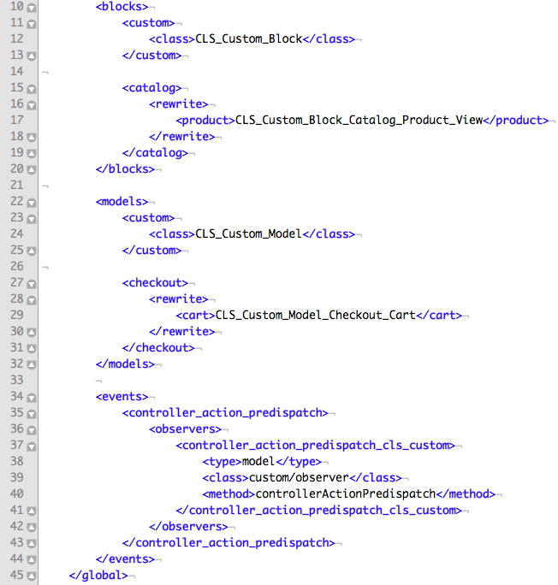
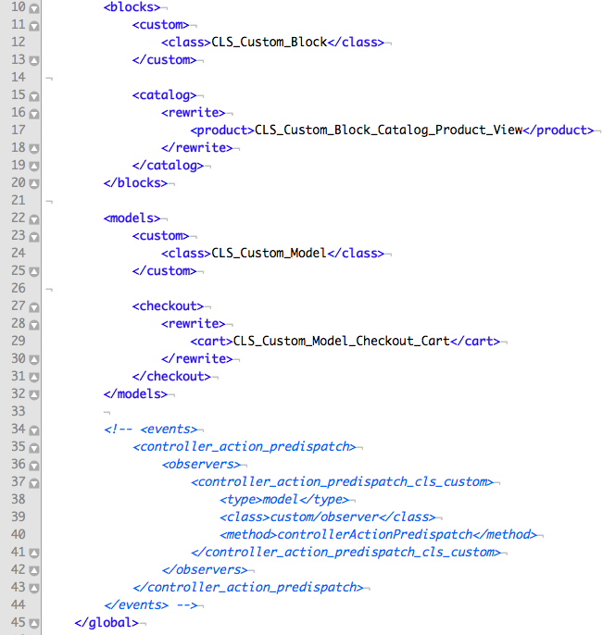
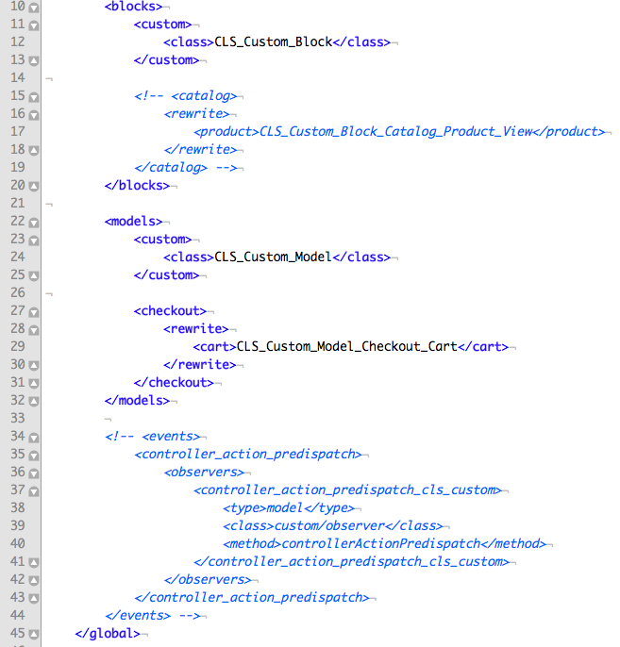
Debugging by Process of Elimination
Once the offending module is identified, comment out sections of config.xml to determine component that is causing the error
1
2
3

Slide 26
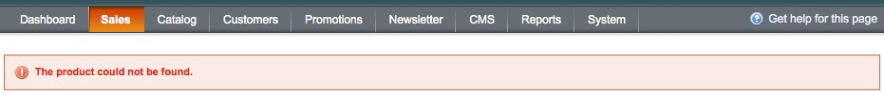

Vague Error Message
Problem: Your client tries to place an order in the admin. When doing so, they get a generic error message about the “The product could not be found”. You check the error and exception logs, but you have nothing to work with. What do you do?
1
2
3
Notes:
•Copy the error message
Search the Magento codebase for the error
Once you locate the error, set a breakpoint
Use debug tools to discover the cause of the error

Slide 27
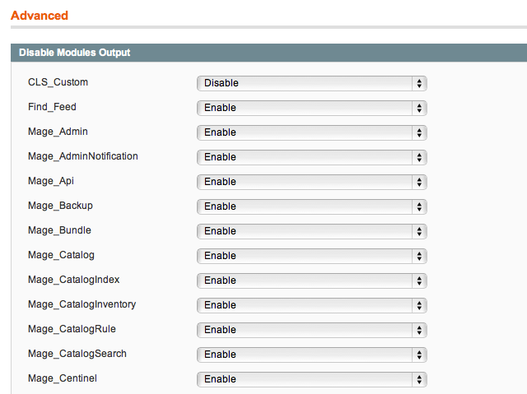
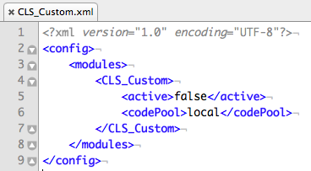
Disabling a module vs disabling block output
VS
Notes:
Disabling block output explained
You can access this option in System > Configuration > Advanced
Disabling a module’s block output makes the XXXX class not output the contents of any blocks in that module
Why would you disable a modules block output as opposed to disabling it?
NOTE: Fill in details
Core Magento classes that are commonly disabled
Mage_Poll, Mage_Review, Mage_Tag, Mage_Wishlist (NOTE: Need to verify that there are no issues disabling these module‘s block output)
Disabling a module
Change the <active>true</active> to false
Remove the module’s config file from app/etc/modules

Slide 28

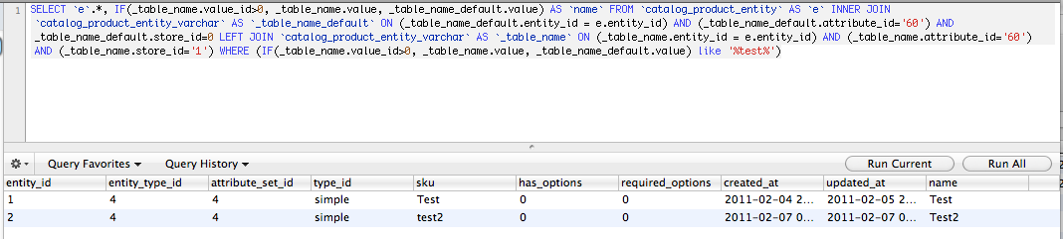
When collections don’t load the items you want
$collection->load(true, true); logs the query to system.log and prints it to screen
You can then use that query in a SQL tool to see why items aren’t loading
Reference this Knowledge Base article for tips on collections: http://bit.ly/h0itx6

Slide 29
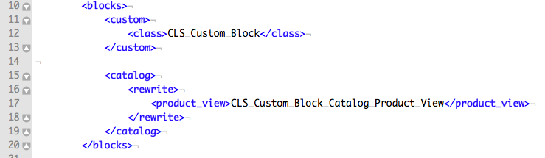
A MoDel/block/helper rewrite won’t work…
Is another module trying to override the same model/block/helper that you’re trying to override?

Slide 30
Mage::log

Slide 31
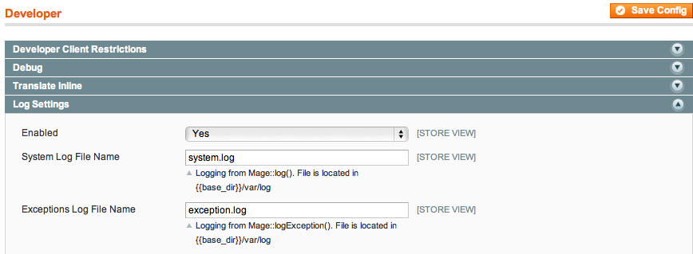
Using Mage::log – Basic Example
Logging is disabled by default.
Enable it in Configuration >
Developer > Log Settings
Mage::log() allows you to log code to either the default var/logs/system.log file, or a custom file.
Message gets logged to var/logs/customfile.log
Notes:
This is helpful if you want to know what code is calling a specific section of code. This can be helpful when testing methods that are difficult to use a debugger on, such as Paypal code

Slide 32
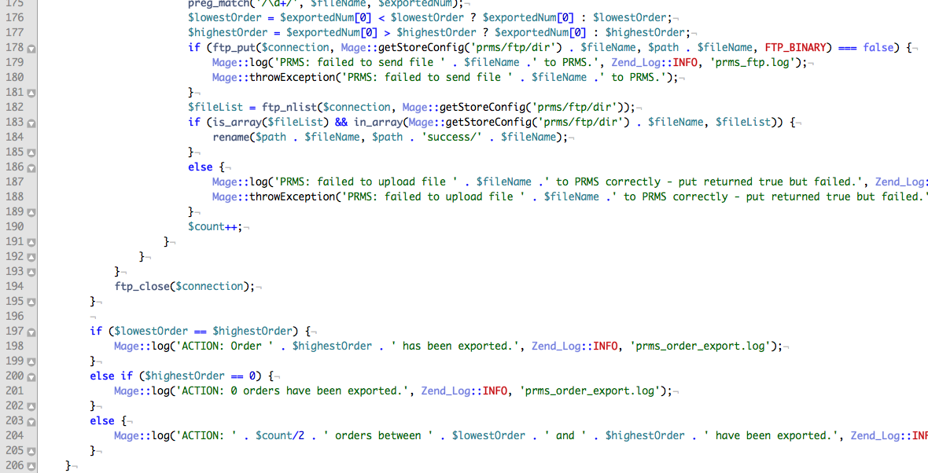
Using Mage::log – Notifications/ERROR NOTICES
Notes:
Preventative method of doing development

Slide 33
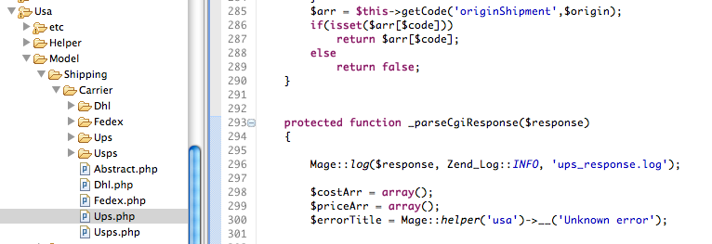
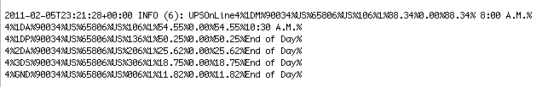
Using Mage::log – Logging API RESPONSES
View XML/CGI responses from API calls, like shipping quote requests

Slide 34
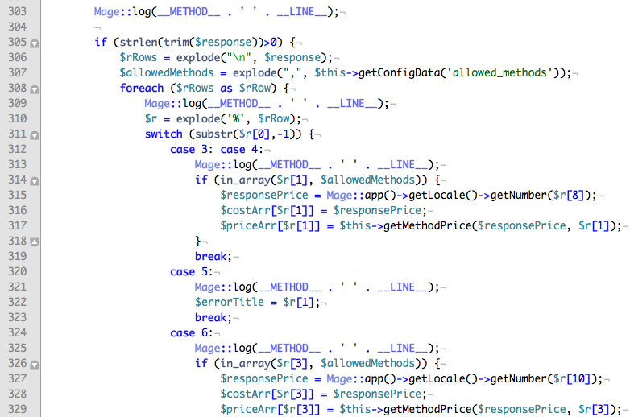
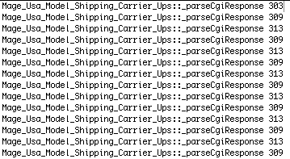
Using Mage::log –determine code coverage
Find out if a certain line of code is getting reached. Alternative to using debugger.
Notes:
TODO: Include example output

Slide 35
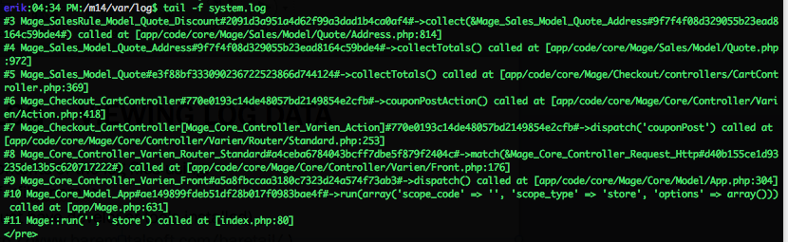
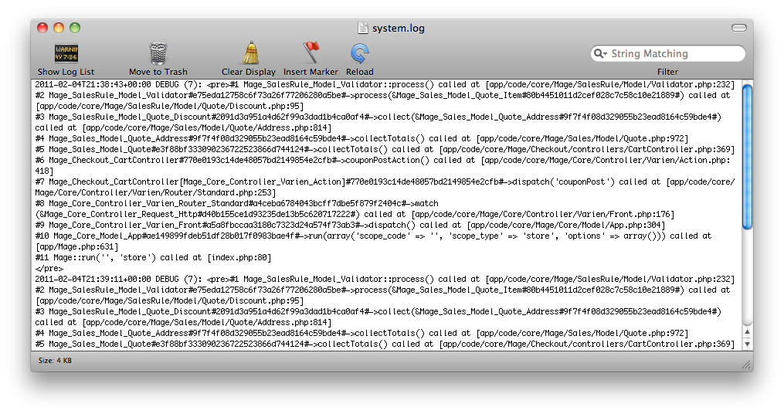
Using Mage::log – Viewing Log data
You can monitor the contents of the log files using:
    Command-line: tail –f <file_name>
    OS X: Console.app (Must have developer tools installed)
    Windows: Baretail (http://www.baremetalsoft.com/baretail/ )

Slide 36
QUICK TIPS

Slide 37
Check the Bug Tracker / forums
Someone may have already solved your problem
If the bug tracker has marked an item as resolved, look in the comments for a code patch, or the SVN trunk

Slide 38
Will a newer version of Magento fix the issue at hand?
Setup upgrade environment and do a quick upgrade to latest production release to see if that solves the issue

Slide 39
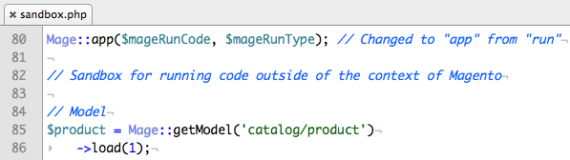
Isolate code in a “sandbox.php” file
Allows you to run code outside of the context of a controller/page
Copy index.php to sandbox.php
Modify Mage::run to Mage::app

Slide 40
General Advice
Don’t get stuck in a certain way of solving problems.
Read (and understand) the code
Before delving into a problem headlong, take a step back and think holistically about the problem
Notes:
Example: Once you get familiar with a debugger, it’s easy to resort to debugging without first reading through the code, checking the bug tracker, etc…
Get up, go get a drink, etc… I’ve had more epiphanies about how to solve problems when going pee than anyplace else

Slide 41
Questions?

Slide 42
Varien_Profiler

Slide 43
Optimizing buggy/SLOW code w/ Varien_Profiler
Find out what events are getting triggered on a page
How many times is your custom code running?
Optimize slow code

Slide 44
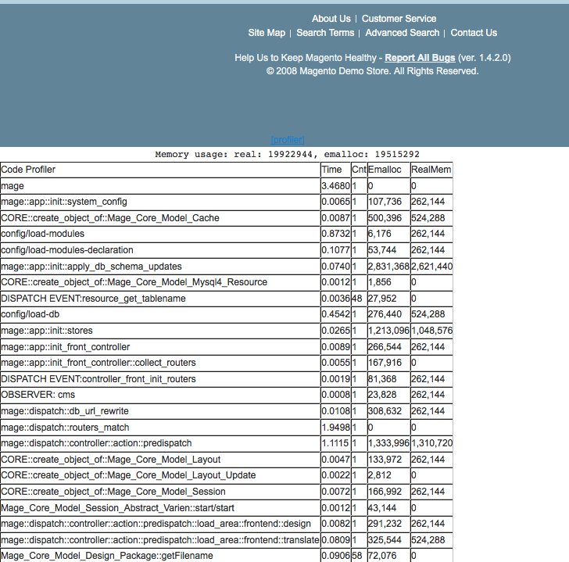
STANDARD magento profile (output in html table)
You must enable profiler in System > Configuration > Developer > Profile
Notes:
Events & their observers, controller dispatches, model loads, etc…

Slide 45
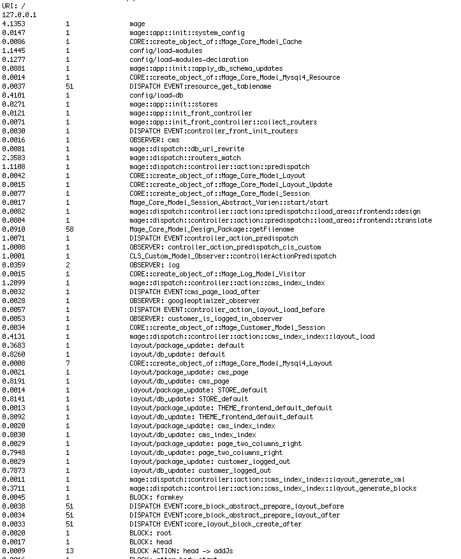
Custom magento profile (output to log file)
Notes:
Useful for Ajax, Paypal responses, API calls, etc…

Slide 46
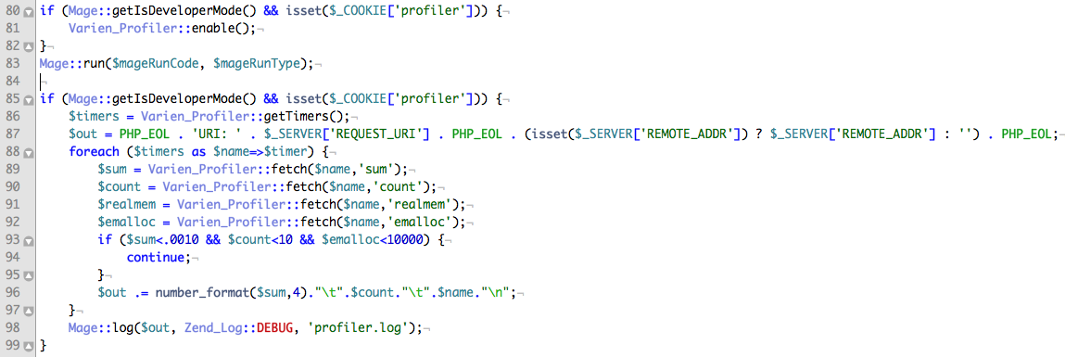
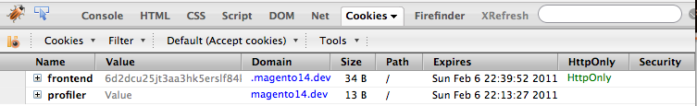
Modify index.php
1
2
Profile gets logged to var/log/profiler.log
3

Slide 47
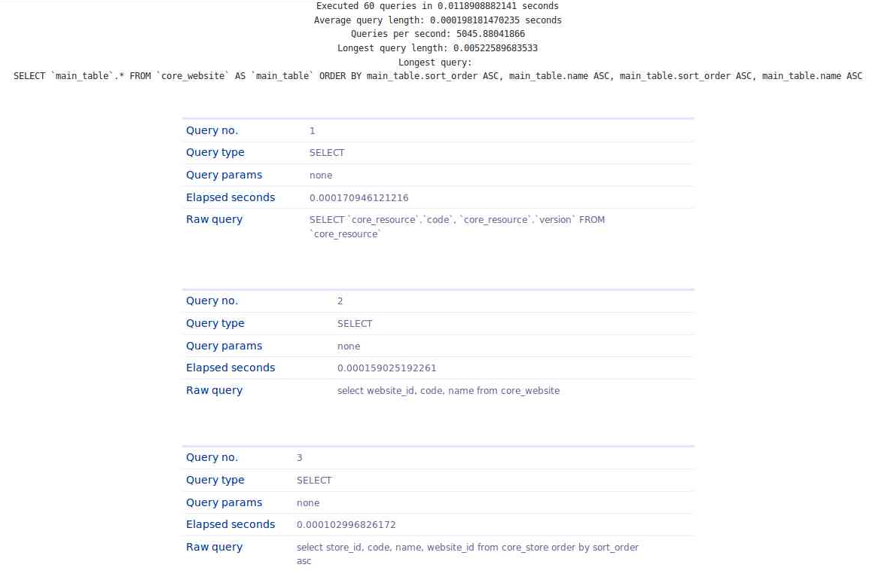
Customized PROFILE that extends native profile With MYSQL queries
Read about how to implement this on Branko Ajzele’s blog: http://bit.ly/geMSrT
Notes:
• Useful to determine what your queries look like
• If a collection isn’t loading, look at and analyze the query

Slide 48
Conclusion
Questions / Thoughts / Job Inquiries: erik@classyllama.com
Code samples referenced in slides available here: http://bit.ly/dNNgxU
Eclipse walkthrough video: http://www.youtube.com/watch?v=6AynpmjW5us

